Slide 1
THIS IS THE EPILIPIDNET PPT TEMPLATE
Some examples in the following slides

Slide 2
This is the EpiLipidNet ppt template
…but a different title slide

Slide 3
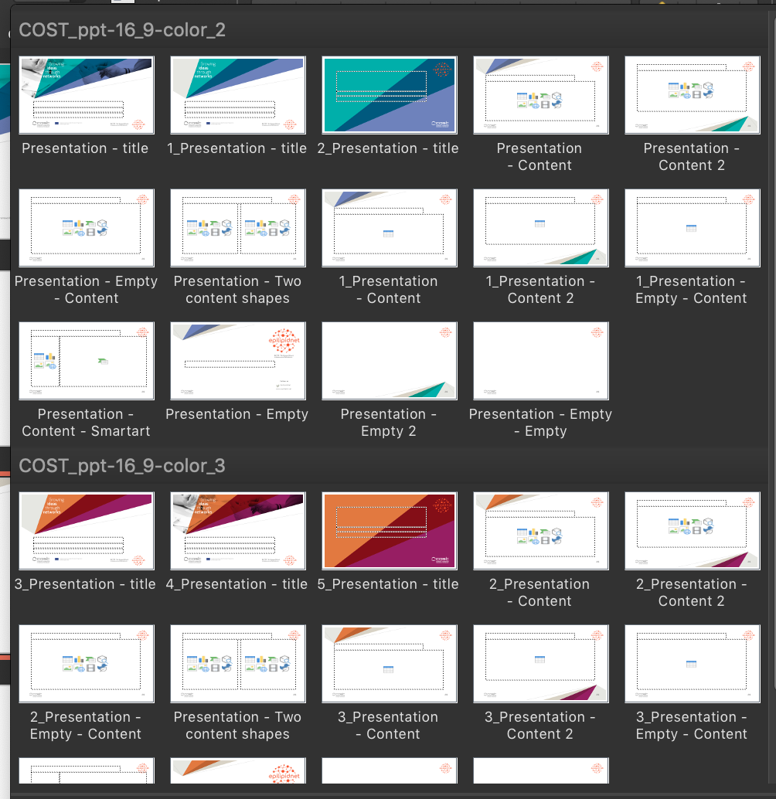
You can choose among different slides format and two different palette, accessible through the «New Slide» menu

Slide 4
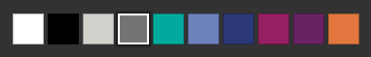
This is the EpiLipidNet template
This is a slide with a different design
The palette is automatically available here

Slide 5
This is the EpiLipidNet template
And this is a very empty slide, if you do not like fancy design

Slide 6
Thank you!

